Slide 1
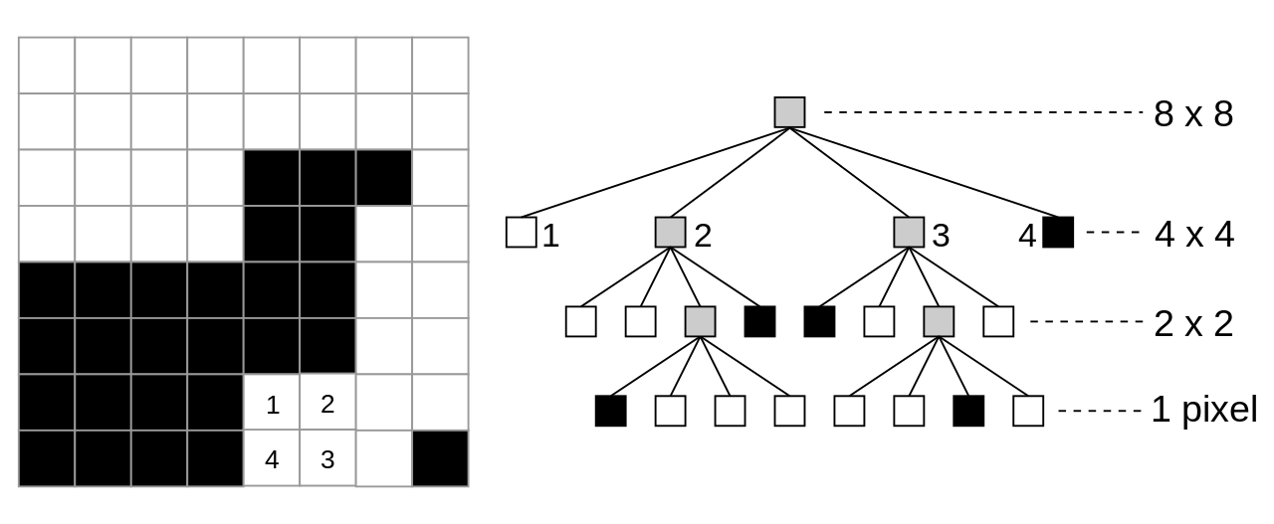

Quad Trees and its Uses
By: Jean Luka Molina
4th March, 2022
Advanced Topics on Data Structures

Slide 2

What are Quad Trees?
Binary Search trees are an efficient data structure to decompose one dimensional information. How about 2D or 3D?
2D = Quad Trees!
3D = Octroees!
Quad refers to the children assigned to each node.
Each node represents a plane
Either a node is a leaf, or it contains four children.

Slide 3

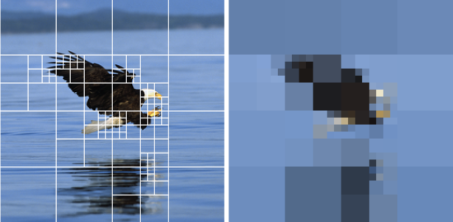
Why should we use Quad Trees
Image Processing/Compression and Representation
Spatial Indexing
Collision Detection (2D)
Storing Sparse data

Slide 4
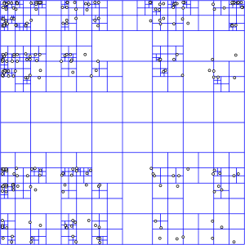
General Algorithm

Slide 5

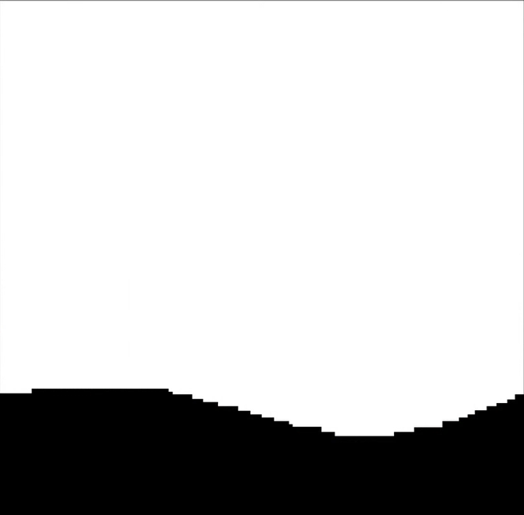
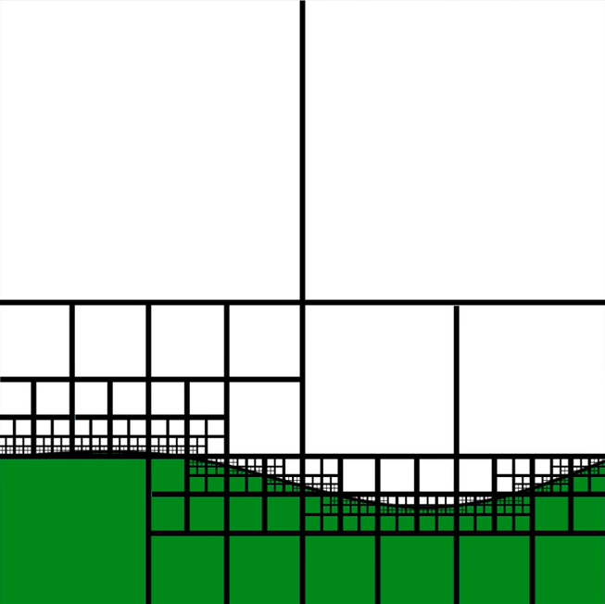
Quad Trees in Videogames

Slide 6
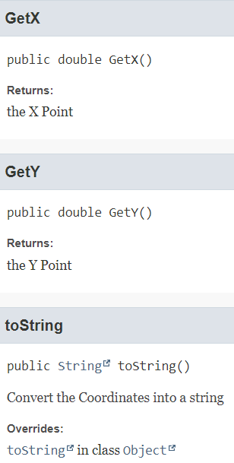
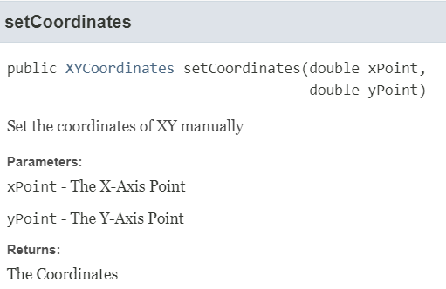
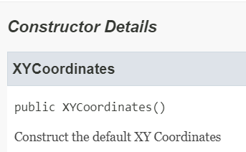
My Implementation (XY-Coordinates)

Slide 7
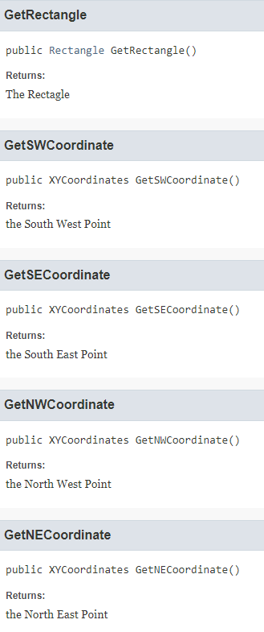
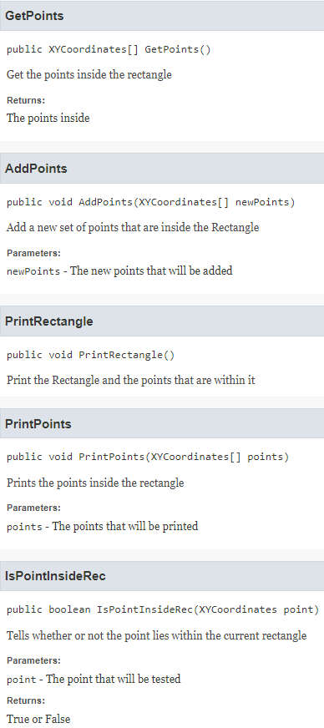
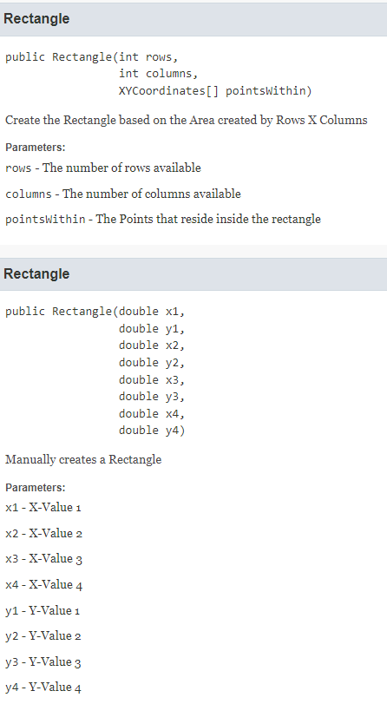
My Implementation (Rectangle)

Slide 8
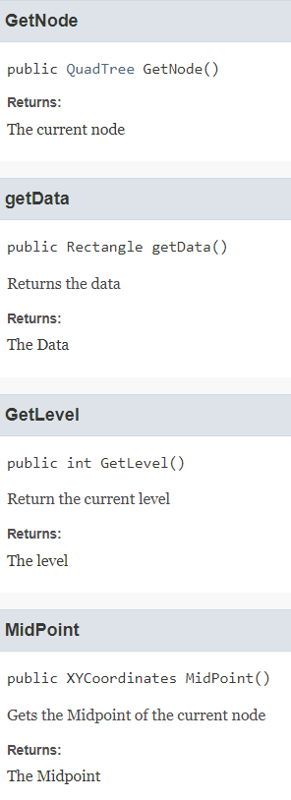
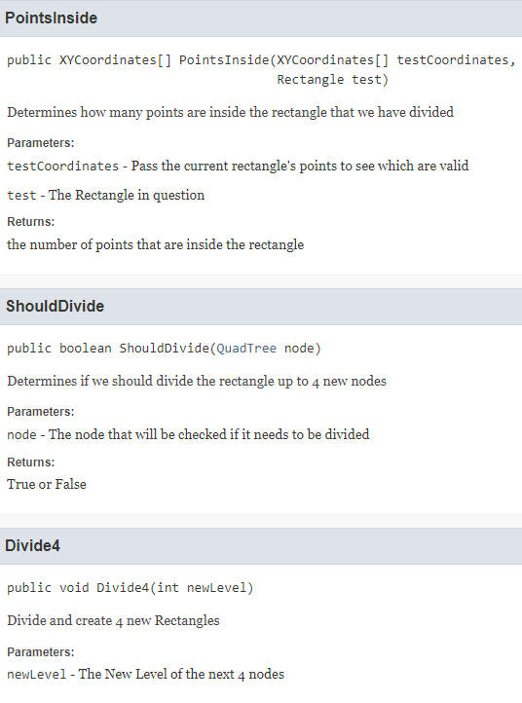
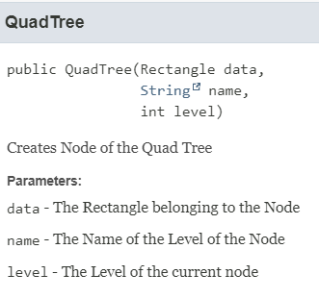
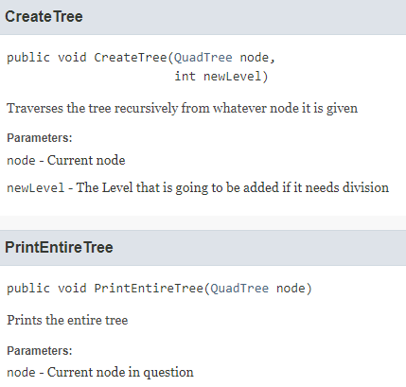
My Implementation (Quad Tree)

Slide 9
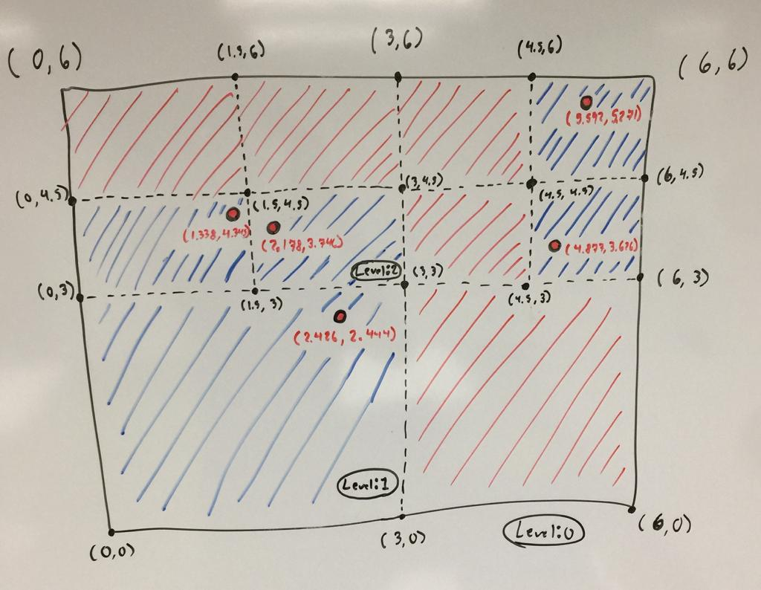
Results

Slide 10
References
https://en.wikipedia.org/wiki/Quadtree
https://www.youtube.com/watch?v=xFcQaig5Z2A&ab_channel=TylerScott
https://www.youtube.com/watch?v=XvISDt21lhA&ab_channel=DaveCarrigg
https://www.youtube.com/watch?v=jxbDYxm-pXg&ab_channel=MrHeyheyhey27
https://www.tutorialspoint.com/quadtrees-in-data-structure
https://www.youtube.com/watch?v=OquPzambxFA&ab_channel=DevOrenge
https://www.youtube.com/watch?v=OJxEcs0w_kE&ab_channel=TheCodingTrain
https://www.youtube.com/watch?v=hCMSHfwYCfU&ab_channel=AamirMushtaqSiddiqui
https://gamedevelopment.tutsplus.com/tutorials/quick-tip-use-quadtrees-to-detect-likely-collisions-in-2d-space--gamedev-374
https://pvigier.github.io/2019/08/04/quadtree-collision-detection.html

Slide 11
Thank you for your attention

